Slide 1
TRAPPING RAINWATER: A SUSTAINABLE SOLUTION
EXPLORING BENEFITS AND TECHNIQUES
BY:CHAUDHARY RISHIKA DHARMATMA
23TMK012 / 12TH NOVEMBER

Slide 2
*REAL WORLD PROBLEM*
Water scarcity is a global challenge, and within this context, the coding challenge of trapping rainwater emerges as a meaningful endeavor. Beyond its algorithmic intricacies, this challenge mirrors a real-world scenario where efficient water management is critical.
Picture a cityscape during a heavy rainstorm. As rainwater flows over rooftops and streets, the potential for efficient collection and storage becomes evident. In urban planning and environmental sustainability, the ability to trap rainwater not only addresses water scarcity issues but also mitigates flooding and soil erosion.
This coding challenge is not just an abstract problem; it resonates with the practicality of optimizing water usage in our communities. As we delve into the algorithmic solutions, keep in mind the tangible impact these optimizations can have on water conservation efforts and the resilience of urban ecosystems. Join us on this journey as we bridge the gap between code and real-world sustainability.

Slide 3
*QUESTION PROBLEM AND SCENARIO+PREREQUISITES
Alright, let's get into the depth of our coding challenge. Imagine we have a row of buildings, and each building has a certain height. We're given this information in the form of an array. Now, here's the puzzle: when it rains, water gets trapped between these buildings. Our goal is to figure out how much water can be trapped.
The array represents the heights of the buildings. It might look like this: [4,2,0,6,3,2,5]. HERE, 0 represents empty ground . Also the width of the building in our case will be considered as 1. Each number is the height of a building at that position. So, how can we efficiently calculate the total amount of trapped rainwater between these buildings? Now, before we jump into the code, let's lay down the rules. We're dealing with a row of buildings represented by an array of heights. Each building's height is a non-negative integer because, you know, buildings can't have negative heights in our world!
So, we might have an array like this: [4,2,0,6,3,2,5]. These numbers are the heights of buildings in our cityscape. Now, when it rains, water can get trapped between these buildings. Our mission? Find out how much rainwater can be trapped efficiently.
Remember, we're not dealing with negative heights here – only real-world buildings with heights you can count. That's the challenge we're diving into, and spoiler alert, it involves some clever coding tricks! Let's explore the coding magic together.

Slide 4
DIAGRAMATIC REPRESENTATION AND SPECIAL SCENARIOS
REPRESENTAION OF OUR GIVEN DATA.HERE IN OUR CASE WE WILL CONSIEDER THE WIDHT OF EACH BUILDING TO BE EQUAL TO 1.
BEOFRE WE UNLEASH OUR CODING SKILLS , LET’S ADDRESS SOME SPECIAL SCENARIOS , IF OUR ROW OF BUILDINGS JUST CONSISTED OF A SINGLE BUILDING , OR IF THE BUILDINGS WERE ARRANGED IN ASCENDING OR DESCENDING ORDER LIKE SHOWN IN THE DIAGRAM, GUESS WHAT? THERE WON’T BE ANY TRAPPED WATER . WHY? BECAUSE IN THESE CASES THERE ARE NO BOUNDARIES BETWEEN BULDINGS FOR THE RAINWATER TO GET TRAPPED. IT’S HAVING A SOLO ACT OR PERFORMING A LINE-UP- NO SPACE FOR RAINWATER TO HANGOUT. KEEP THIS IN OUR MIND AS WE CARFT OUR SOLUTION.

Slide 5
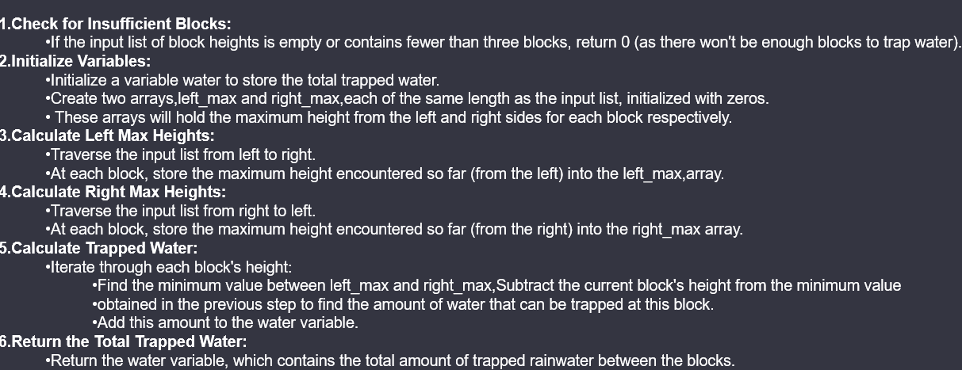
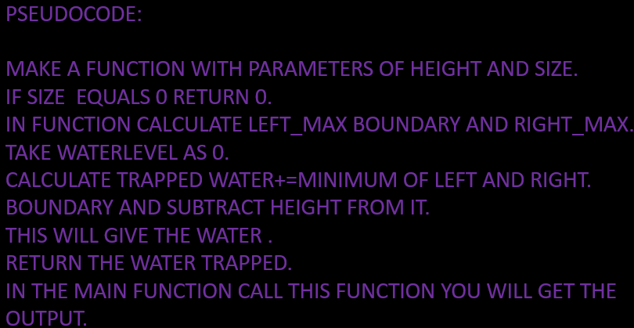
APPROACH I'm tapping into the power of functions and arrays to crack this coding puzzle. Functions help organize my code, making it readable and efficient. Arrays are my go-to for storing building heights. By combining these, I'm set to tackle the rainwater trapping challenge with precision. We're using a two-pointer approach, iterating from both ends. Left_max and right_max keep track of the highest building encountered from the left and right. This ensures precise calculation of trapped rainwater as we move through the buildings. THE WATER TRAPPED ON EACH BUILDING CAN BE GIVEN BY THE FORMULA (WATERLEVEL-HEIGHT)*WIDTH BUT HERE WIDTH IS 1.

Slide 6
FLOWCHART***
START
WATERLEVEL=MIN(LEFT_MAX AND RIGHT_MAX)
INPUT ARRAY OF HEIGHTS
TRAPPEDWATER=WATERLEVEL-HEIGHT(i)
N=0
PRINT “0”
DISPLAY TRAPPEDWATER
CREATE LEFT_MAX AND RIGHT_MAX AUXILLARY ARRAYS
END
LEFT_MAX IS MAX OF LEFT_MAX(i) and HEIGHT(i)
RIGHT_MAX IS MAX OF RIGHT_MAX(N_!) AND HEIGHT(I)
INITIALISE WATER LEVEL

Slide 7
#include<stdio.h>
int trapped_water(int height[], int n) {
if (n == 0) {
return 0; // Handle the case of an empty array
}
int left_max[n]; // Array to store the left max heights
int right_max[n]; // Array to store the right max heights // Calculate left_max for each position
left_max[0] = height[0];
for (int i = 1; i < n; i++) {
left_max[i] = (left_max[i - 1] > height[i]) ? left_max[i - 1] : height[i];
}
// Calculate right_max for each position
right_max[n - 1] = height[n - 1];
for (int i = n - 2; i >= 0; i--) {
right_max[i] = (right_max[i + 1] > height[i]) ? right_max[i + 1] : height[i];
}
int trapped_water = 0;
for (int i = 0; i < n; i++) {
int water_level = (left_max[i] < right_max[i]) ? left_max[i] : right_max[i];
trapped_water += (water_level - height[i] > 0) ? water_level - height[i] : 0;
}
return trapped_water;
}
int main() {
int height[] = {4, 2, 0, 6, 3, 2, 5};
int n = sizeof(height) / sizeof(height[0]);
printf("%d\n", trapped_water(height, n));
return 0;
}

Slide 8
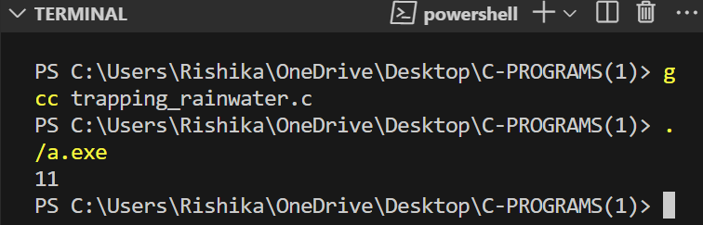
RUNNING THIS CODE IN VISUAL STUDIO WITH GCC COMPILER , OUTPUT = 11,
SO THE TOTAL WATER TRAPPED IN THIS PARTICULAR PROBLEM IS 11.
Time Complexity: The time complexity of the rainwater trapping algorithm is O(n), where n is the length of the input array. This linear time complexity arises from the single pass through the array while maintaining two pointers, left and right, and calculating the left_max and right_max arrays. Each element of the array is visited once, and the maximum and minimum values are updated in constant time.
Summary: The project focused on solving the rainwater trapping problem using a two-pointer approach. The algorithm efficiently calculates the amount of trapped rainwater between buildings based on their heights. The key concepts included maintaining left_max and right_max arrays to optimize the calculation process. The code was implemented in C, and the project was concluded by analyzing the time complexity, which is linear (O(n)), indicating its efficiency for larger datasets. Future work suggestions involve exploring optimizations to reduce space complexity further. The algorithm offers a practical solution for water management scenarios in a real-world context.

Slide 9
THANK YOU

